Slide 1
Orange County
Groundwater Vulnerability
Assessment
Work Session
Orange County Board of County Commissioners
June 6, 2023

Slide 2
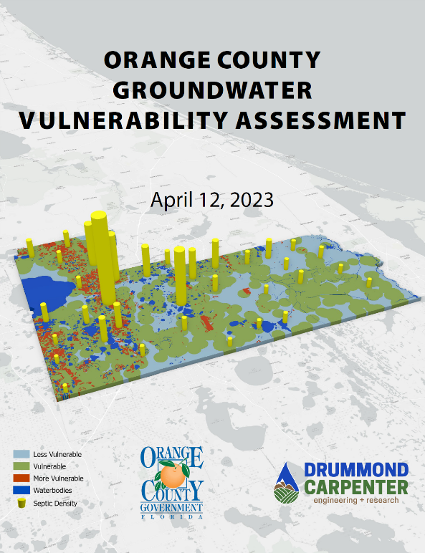
Presentation Outline
Background
Groundwater Vulnerability Assessment
Recommendations
Stakeholder Engagement
Next Steps
Summary
Notes:
Good morning Mayor, good morning Commissioners.
EPD would like to provide you with information about a recently concluded project which will assist the county in addressing nutrient dsicharges from septic systems.
This presentation will walk you through the project background, the assessment, and finish with a summary.

Slide 3
Presentation Outline
Background
Groundwater Vulnerability Assessment
Recommendations
Stakeholder Engagement
Next Steps
Summary

Slide 4
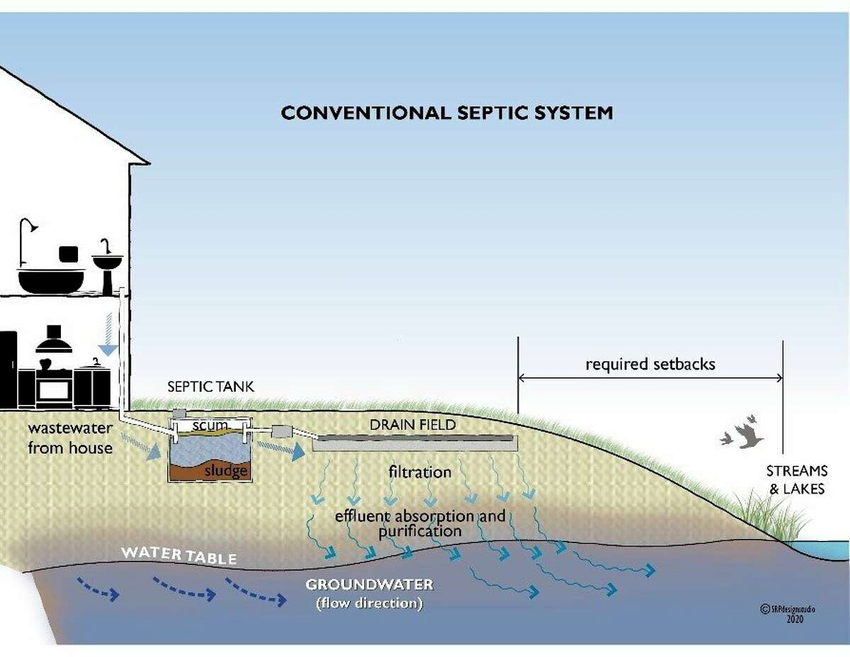
Background
Conventional septic systems are effective in the right locations and at the right densities
Groundwater can transport nutrients to surface water
Excessive nutrient loading to surface waters can degrade water quality and surrounding biological communities
Notes:
Over 150 water quality impairments on 87 waterbodies
Approximately 2/3 of these impairments are the result of excess nutrients

Slide 5
Background
State legislation addressing septic system impacts:
  Florida Springs and Aquifer Protection Act (2016)
  State Clean Waterways Act (2020)
    Requires Orange County to incorporate plans addressing Onsite Septic Treatment Disposal Systems (OSTDS) into nutrient BMAPs by July 1, 2025
  House Bill 1379 (2023)
    Prohibits new OSTDS within a BMAP, 4E/4A Reasonable Assurance Plan, or pollution reduction plan where sewer is available. On lots one acre or less where sewer is not available, new OSTDSs must be an enhanced systems or other treatment system that achieves at least 65% nitrogen reduction.
May result in future updates to Chapter 37, Water and Wastewater, Orange County Code.
Notes:
The 2016 Springs Protection Act created the Wekiwa Springs Priority Focus Area (PFA).
The Clean Waterways act requires Orange County create a plan to address wastewater and septic system discharges and submit it to the state.
Draft plans due July 1, 2024.
FDEP will adopt final plans into the nutrient BMAPs by July 1, 2025.
Plans will be adopted into the Basin Management Action Plans within Orange County.
House Bill 1379 prohibits new septic systems within a BMAP area, a 4E/4A remedial Assurance plan, or where central sewer is available.
On lots one acre or less where there is no central sewer, advanced treatment systems achieving 65% nitrogen reduction can be used.

Slide 6
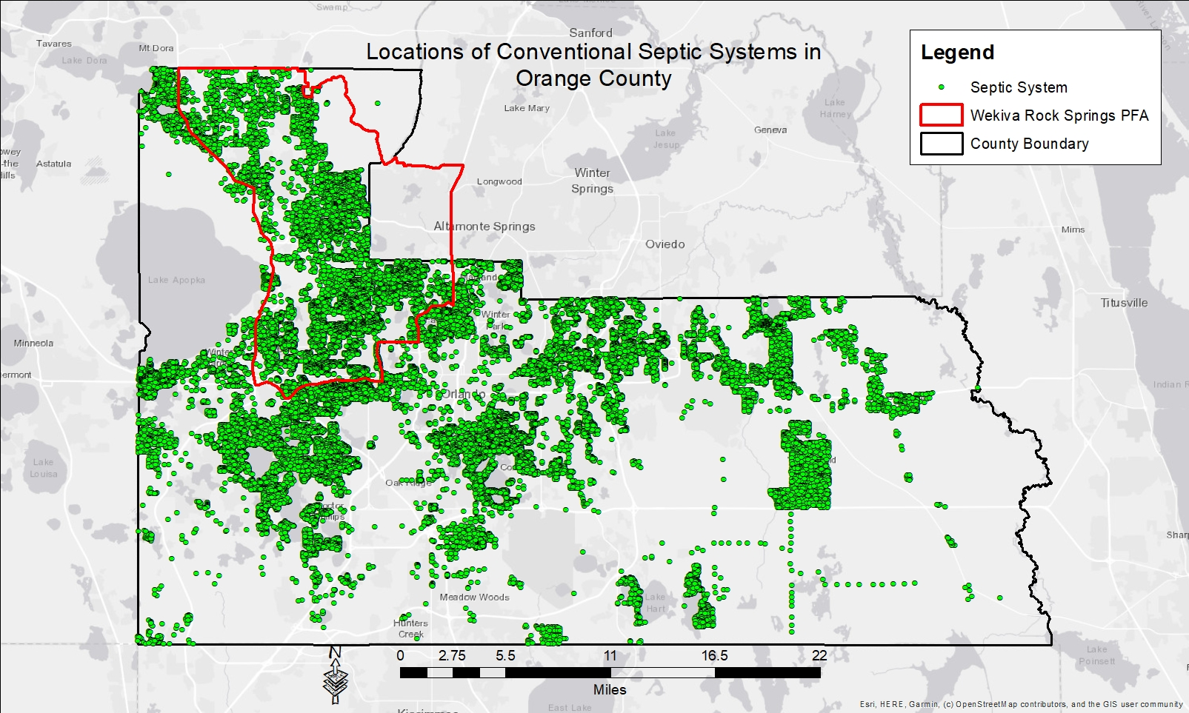
Background
Notes:
Here are the approximately 86,000 septic systems across Orange County.
The red boundary is the Wekiwa PFA where FDEP is already addressing septic systems .
How does OC address the remaining septic systems in unincorporated OC?
This is where the Groundwater Water Vulnerability Assessment (GVA) comes in.
The GVA will help identify areas vulnerable to nutrients from septic systems and help Orange County focus its efforts.

Slide 7
Background
Distribution of Conventional Septic Systems in Orange County
District | Orange County | OCU Service Area Inside Wekiva PFA | OCU Service Area Outside Wekiva PFA
1 | 13,010 | 0 | 12,890
2 | 27,732 | 14,000 | 585
3 | 14,457 | 0 | 11,426
4 | 2,252 | 0 | 2,412
5 | 18,067 | 22 | 8,541
6 | 10,324 | 3,740 | 6,025
Total | 85,932 | 17,762 | 41,879
Notes:
This table provides a summary of the preceding figure.
Of the 86,000 septic systems, about 42,000 septic systems are within the OCU Service area and outside of the PFA.
About 50% of the septic systems fall outside of the PFA?
That’s still a lot of septic systems to address.
How do we prioritize efforts?

Slide 8
Background
Purpose of the Groundwater Vulnerability Assessment (GVA)
Which waterbodies are most vulnerable to excessive nutrient loading from existing conventional septic systems?
Where should use of conventional septic systems be restricted for new development?
Where should connections to the central sewer or upgrading to advanced septic systems be prioritized for existing conventional septic systems?
Are current setback requirements from septic systems in code adequate to protect nearby surface waters?
Notes:
The GVA helps OC focus its efforts and is fundamental to the work of each of the Septic Tank Workgroup Subgroups.
This slide summarizes some of the fundamental questions that the assessment and Subgroups are seeking to answer:
Conventional septic systems that are not near surface waters or springs are not likely to be a significant concern. However, some conventional septic systems are close enough to waterbodies that they can have an adverse impact on water quality. So, a key question we are trying to answer with the assessment is “Which waterbodies are most vulnerable to excessive nutrient loading from septic systems?”
If a waterbody is more vulnerable to nutrient loading, then it would be prudent to restrict conventional septic systems in areas where they could lessen water quality?
It is expensive to connect existing septic systems to central sewer or to upgrade septic systems to advanced treatment units. So, it makes sense to have a method for prioritizing the use of resources to address the areas of greatest concerns first.
There are setback requirement for septic systems from surface waters established in the current code, but we thought it was also important to evaluate whether or not those setbacks were adequate using the best models and science currently available.

Slide 9
Presentation Outline
Background
Groundwater Vulnerability Assessment
Recommendations
Stakeholder Engagement
Next Steps
Summary

Slide 10
Groundwater Vulnerability Assessment
GVA Methodology
  Determine categories of groundwater areas that are more vulnerable, vulnerable, or less vulnerable to contamination from septic systems (based on the 2005 FGS FAVA model).
  Rank subdivisions by their potential to discharge septic system nutrients to groundwater or water bodies
  Create a list of waterbodies of interest and establish their capture zones and how long it takes nutrients to reach the waterbody
  Identify Orange County Priority Vulnerability Areas (PVAs) by merging subdivision septic sources and waterbody influence zones
Notes:
Based on the 2005 Florida Aquifer Vulnerability Assessment by Florida Geologic Survey.
Identify groundwater area classified as being: MORE VULNERBALE, VULNERABLE, LESS VULNERABLE to contamination from septic systems.
Rank subdivisions by their potential to discharge nutrients to water bodies.
Create a list of waterbodies that are targets for septic system nutrients.
Let’s walk through the steps.
Phase II Rank the current PFAs and prioritize potential septic system interventions.
Consider future growth, consider influence of water quality trends.
Remaining 10% of the vulnerability assessment.

Slide 11
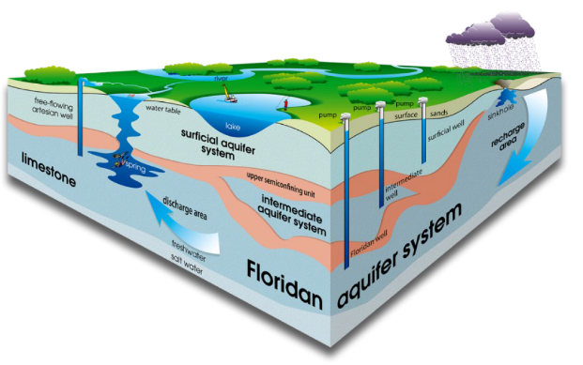
Groundwater Vulnerability Assessment
1. Determine groundwater vulnerabilities
The vulnerability model uses data to produce a map of areas where groundwater is vulnerable to discharges from conventional septic systems
Areas where the local data combines to produce vulnerability categories
Notes:
The GVA uses data collected in Orange County, so it is a local assessment.
Data is combined to determine where groundwater are vulnerable.
Vulnerability is classified as MORE VULNERABLE, VULNERABLE, or LESS VULNERABLE.

Slide 12
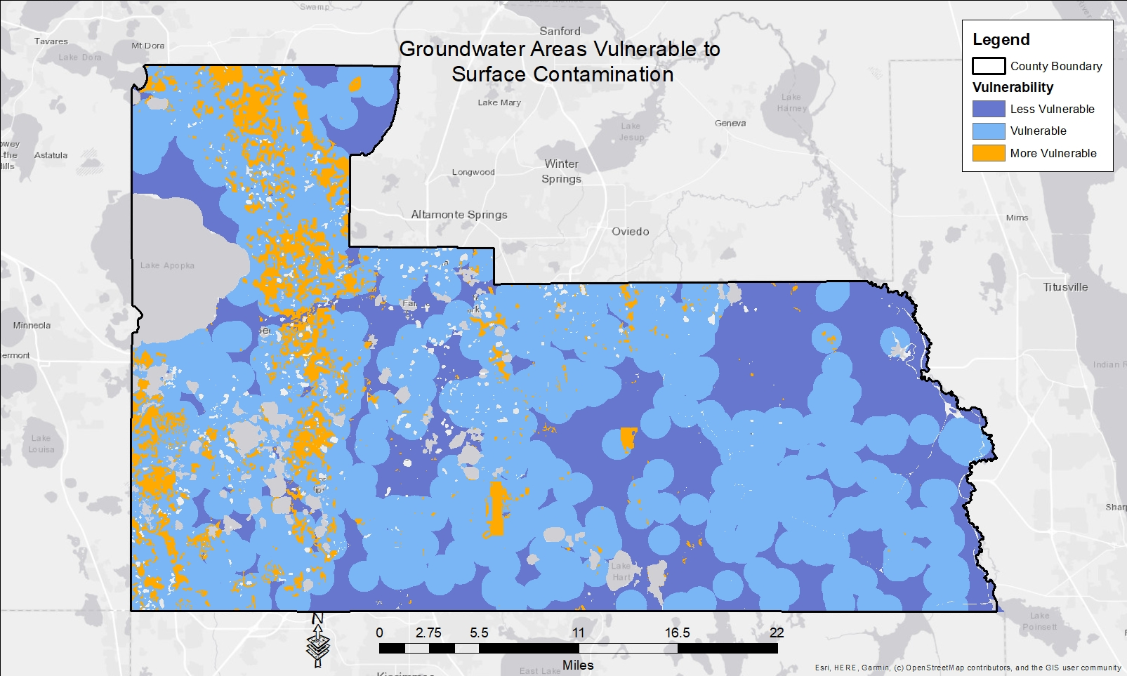
Background
Notes:
This is the groundwater vulnerability map.
Orange groundwater areas are where soil types and distance to the aquifer combine to produce MORE VULNERABLE groundwater areas.
You can see that groundwater in the surficial aquifer vulnerability is greatest on the west Orange County soils are sandy and kart is close.
If we roll out to the west side of the county, you can see that groundwater is VULNERABLE or LESS VULNERABLE. On the east side, soils less sandy and the karst is further from the surface.`

Slide 13
Groundwater Vulnerability Assessment
2. Subdivision Ranking
Rank subdivisions by the potential for their conventional septic systems to discharge nutrients to groundwater
Ranked by density of conventional septic systems, distance to a water body, percent of the subdivision in an impaired watershed, etc.
Produce a heat map of subdivision rankings
Notes:
Septic systems are found in subdivisions across Orange County.
The GVA ranks subdivisions by their potential to discharge nutrients to groundwater.
Subdivisions with high numbers of septic systems, or are close to a waterbody rank higher.
The GVA method produces a heat map of subdivisions and their potential to discharge nutrients to groundwater.

Slide 14
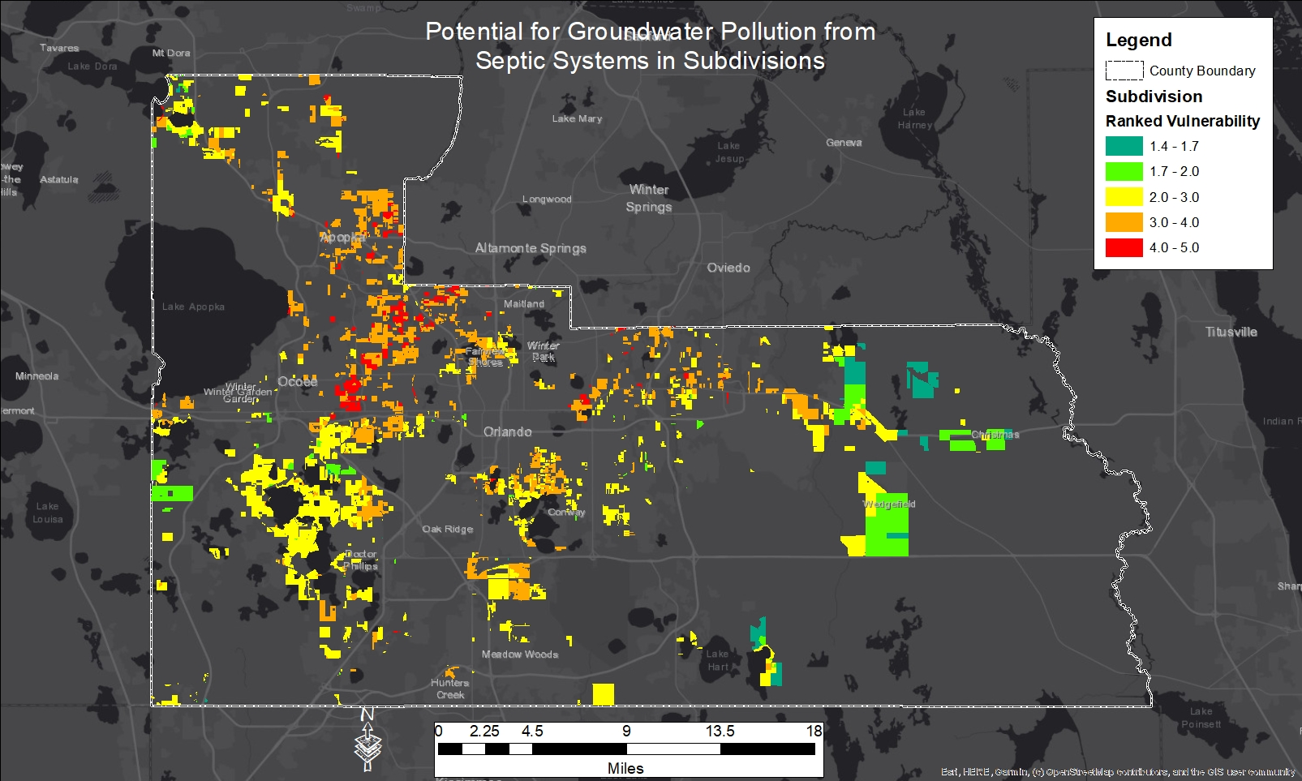
Background
Notes:
Here is that heat map.
Areas in the warmer colors, red and orange, have septic systems with a greater potential to discharge nutrients to groundwater.
Areas in the green and blue-green have a lower potential to discharge nutrients to groundwater.
The “heat” is driven by the density of the septic systems and other factors.

Slide 15
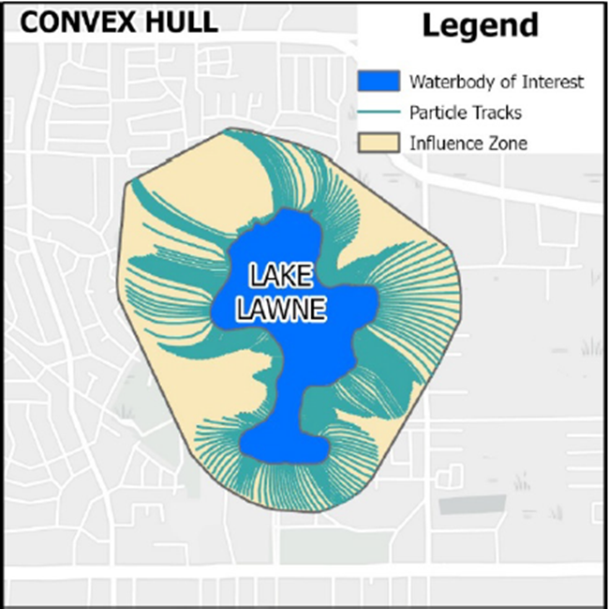
Groundwater Vulnerability Assessment
3. Determine waterbodies of interest and their capture zones
A water body of interest:
  Has one or more impairments, has a TMDL, is located within a BMAP, is an OFW , Is within a closed basin or known karst area
  Is adjacent to areas with a high density of conventional OSTDSs
Use a regulatory groundwater model to establish capture zone and travel times to the water bodies of interest
Notes:
Once septic system discharges enter the groundwater, where do they go?
To find out, vendors created a list of 172 “Waterbodies of Interest”
A WBOI is a waterbody that is impaired, or has an adopted TMDL, is in a BMAP area, etc.
To find if the WBOI will be impacted by septic systems, we use a regulatory groundwater model
The model produces a boundary within which septic systems will discharge to the waterbody.
In the picture above, septic systems discharging within the boundary will impact the lake. Here, Lake Lawne.

Slide 16
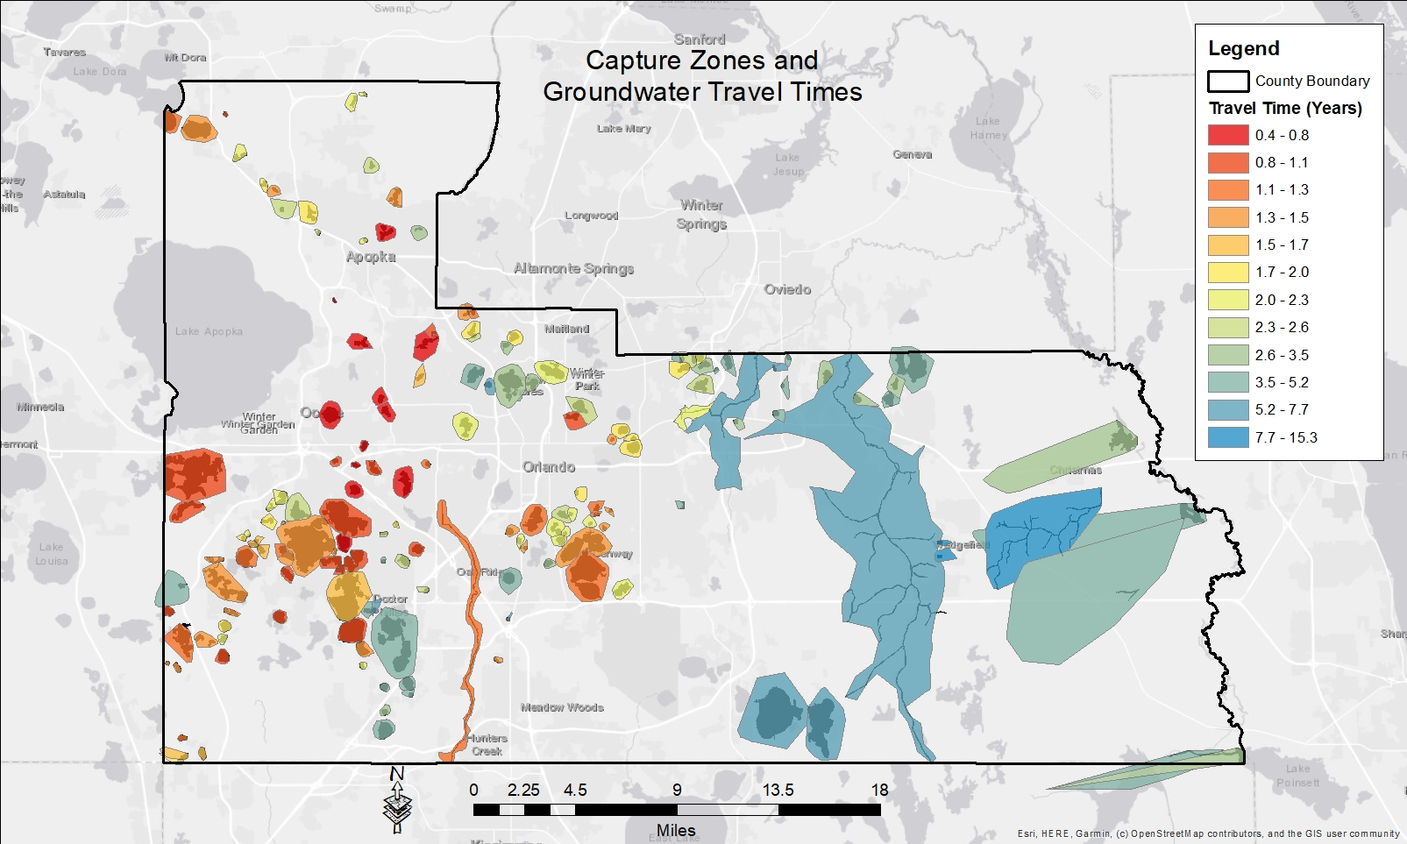
Background
Notes:
This is a map of WBOI capture zones and travel times to the waterbody of interest.
Take a little time to explain the graphic:
WOI – water body of interest. Remember these are water bodies already impaired, OFWs, TMDLs, etc.
Capture Zones – this is the envelope the WOI sits in. Discharges from septic systems in the envelope can travel to the WOI.
Heat map – warm colors faster travel time, cool colors slower travel times. Subdivisions with score represented by color superimposed on top.
Now let’s put it all together…

Slide 17
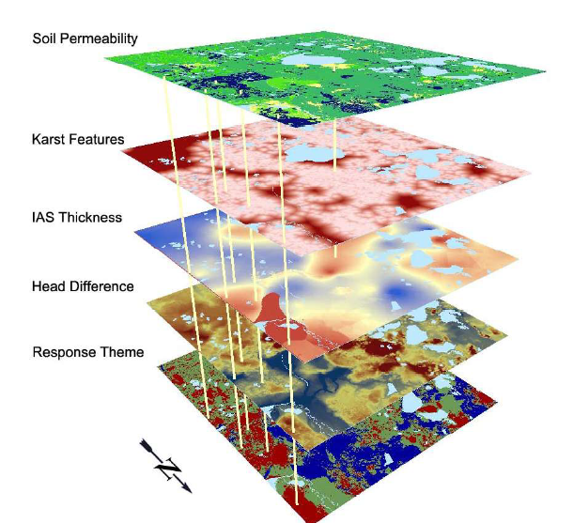
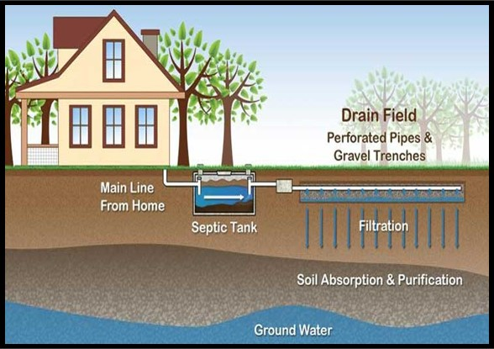
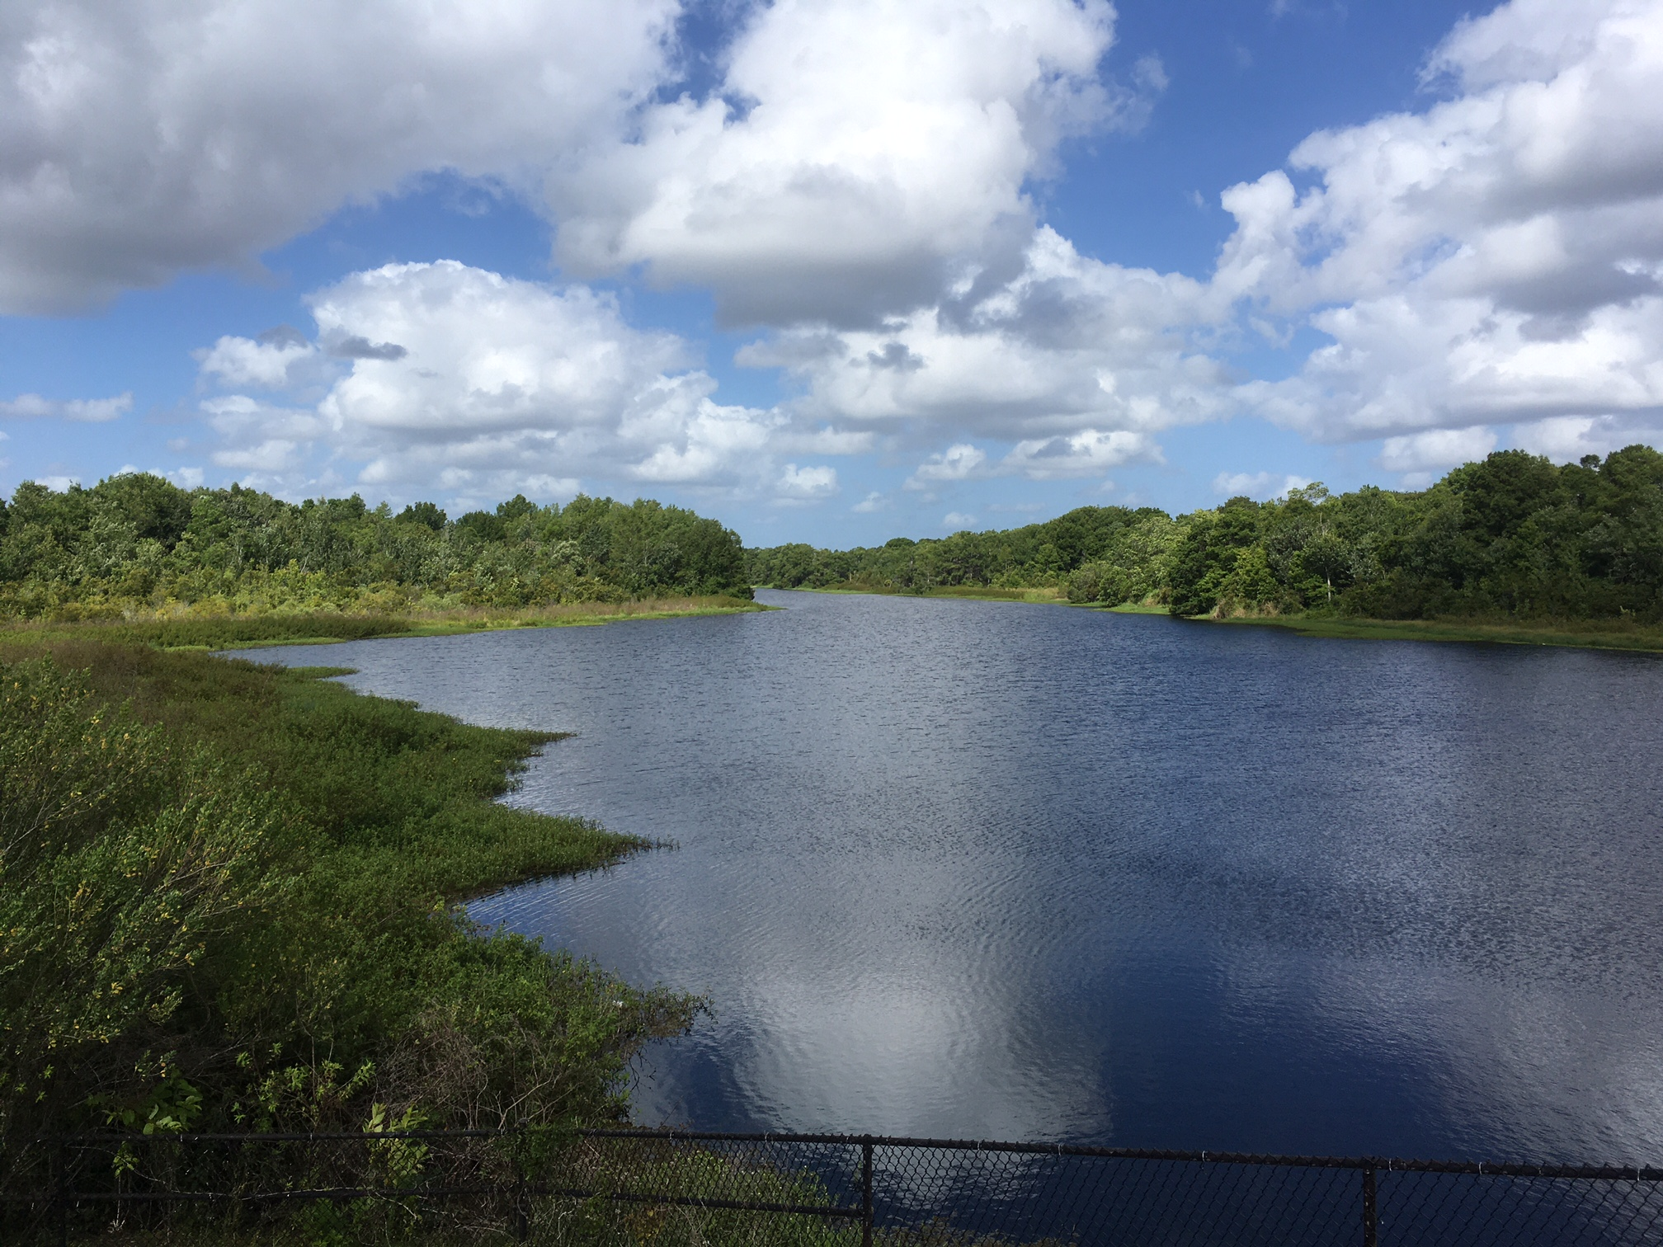
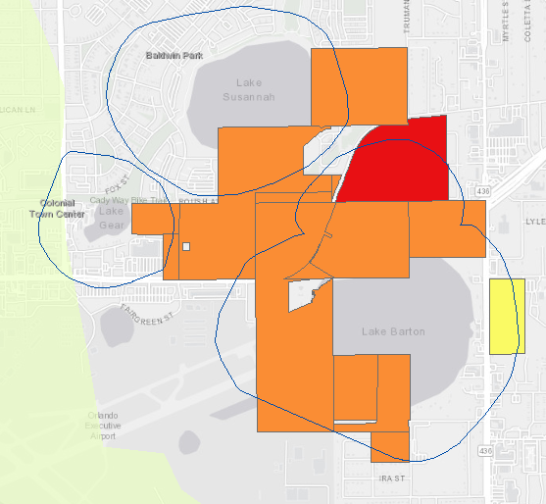
Groundwater Vulnerability Assessment
4. Identify Orange County Priority Vulnerability Areas (PVAs)
More Vulnerable Areas
Subdivisions with Septic Systems
Proximity to Waterbodies
PVAs
Easy Flow to Groundwater
Source of
Nutrients
Target of
Nutrients
Priority Vulnerability
Areas
Notes:
White out convex3

Slide 18
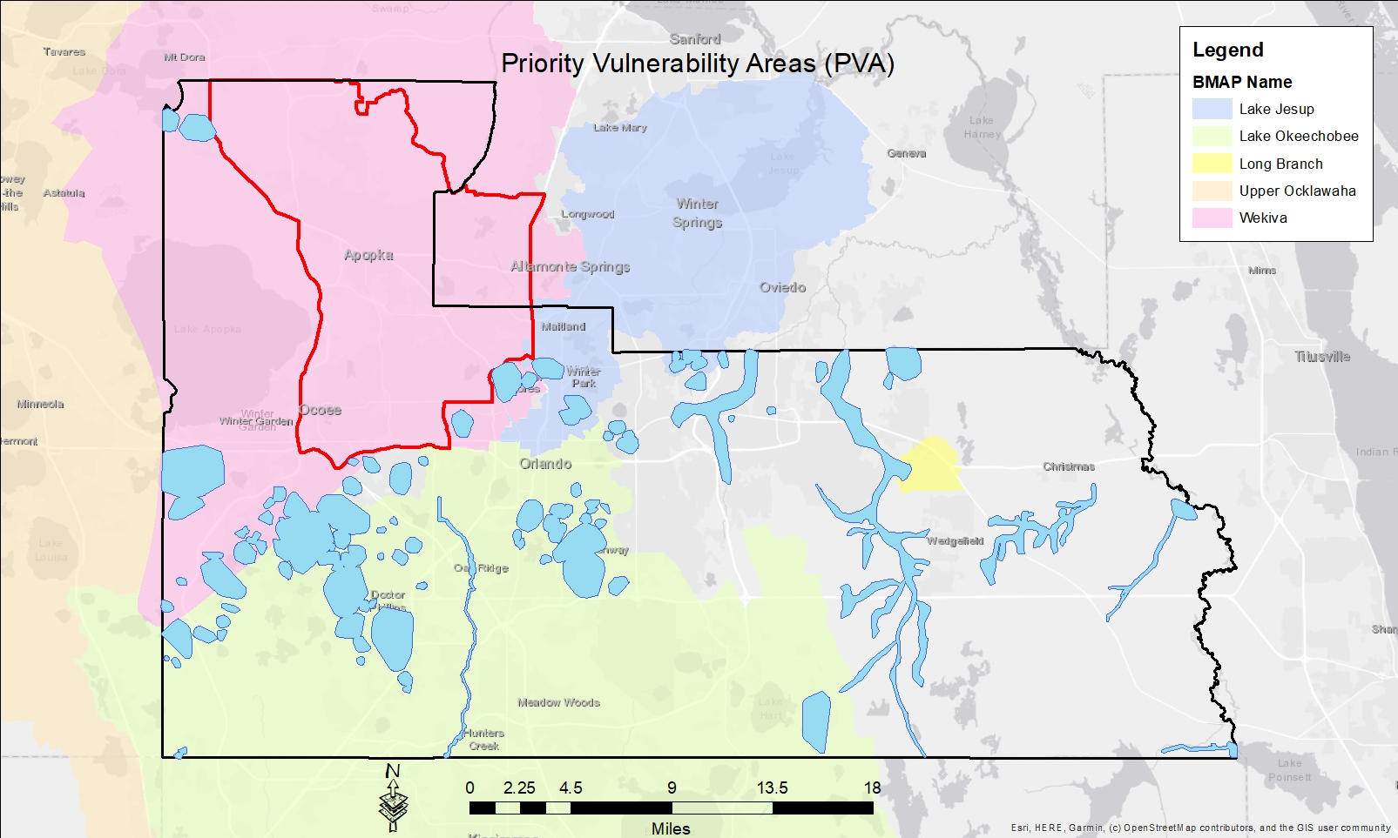
Background
Notes:
Here are the PVAs
65 PVAs
5 BMAPs
We can drill down further by asking which septic systems are located in the PVAs?

Slide 19
Background
Distribution of Conventional Septic Systems in Orange County
District | OCU Outside the Wekiva PFA | Inside PVAs | Outside PVAs
1 | 12,936 | 4,994 | 7,942
2 | 584 | 0 | 584
3 | 11,396 | 3,875 | 7,521
4 | 2,394 | 453 | 1,941
5 | 8,551 | 1,614 | 6,937
6 | 6,018 | 905 | 5,113
Total | 41,879 | 11,841 | 30,038
Notes:
Here are the 41,879 septic systems located in the OC service area and outside of FDEP’s priority focus are (red boundary)
Of those 41,879 septic systems, 11,841 systems (about 28%) are located within an Orange County Priority Vulnerability Area (PVA)
Here is a map of the PVAs:

Slide 20
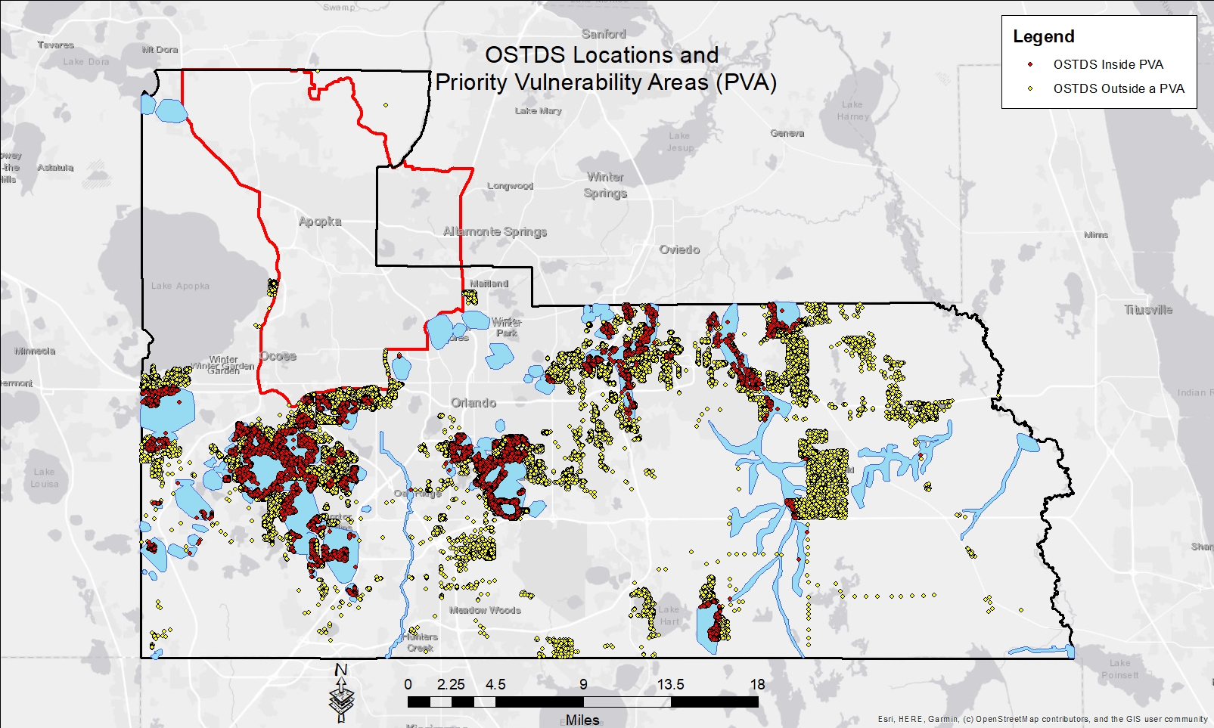
Background
Notes:
Red symbols are septic systems within a Orange County PVA
Yellow symbols are septic systems outside of a Orange County PVA

Slide 21
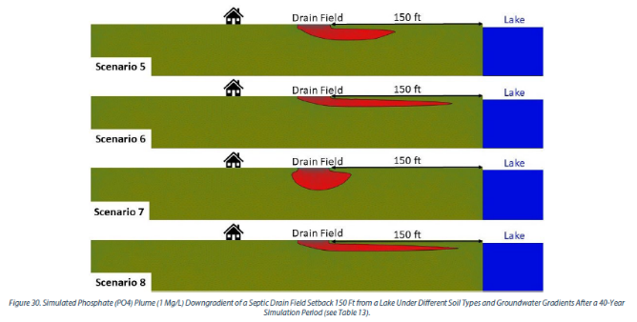
Groundwater Vulnerability Assessment
Evaluating septic system setbacks
Eight different modeling scenarios evaluating septic system impacts
Install advanced treatment systems in areas with high water tables
Connect conventional systems to central sewer or require advanced systems
Require larger setbacks from water bodies
Notes:
Eight modeling scenarios were used to evaluate septic system impacts.
The models used different combinations of soil types, water table height, and system type (conventional vs advanced treatment).
Shallow groundwater table – higher pollution potential; Great hydraulic conductivity – higher pollution potential
Install advanced treatment systems in areas with high water tables.
Connect to central sewer or install advanced treatment systems.
Require larger setbacks from waterbodies.
Scenario 6: Sandy soils, high water table.
Scenario 8: Silty soils, low water table.

Slide 22
Presentation Outline
Background
Groundwater Vulnerability Assessment
Recommendations
Stakeholder Engagement
Next Steps
Summary

Slide 23
GVA Recommendations for Consideration
Orange County created a Workgroup to identify actionable OSTDS interventions to mitigate and prevent impairments to water bodies
  Septic Working Group Overview presented to the BCC (02/22/2022)
Subgroups presented before the Board in 2022 to discuss various issues related to septic tanks
  Subgroup A - new development connections to central sewer (07/12/2022)
  Subgroup B - existing septic-to-sewer connections (06/21/2022)
  Subgroup C - existing septic tank upgrades (08/30/2022)
  Subgroup D - new septic tank standards and permitting (09/13/2022)
Notes:
Septic Working Group create in 2022 to address adverse impacts to water bodies attributed to conventional septic systems
Working Group split into four (4) Subgroups.
Subgroups will use the GVA with other factors to evaluate solutions to septic system nutrient loading to water bodies.

Slide 24
GVA Recommendations for Consideration
Subgroup A (new development connecting to central sewer)
Consider increasing the distance for which connection to central sewer is required for new developments in vulnerable areas
Subgroup B (existing septic-to-sewer connections)
Conduct septic-to-sewer feasibility studies
Develop potential funding strategies
Evaluate how new policies may be used to address nutrient BMAP requirements

Slide 25
GVA Recommendations for Consideration
Subgroup C (existing septic tank upgrades)
Consider requiring failing septic systems to upgrade to advanced treatment systems
Require existing septic systems within a setback to be upgraded to advanced treatment systems
Develop funding strategies
Develop an interagency agreement between Orange County and FDOH/FDEP

Slide 26
GVA Recommendations for Consideration
Subgroup D (new septic tank standards and permitting)
Consider prohibiting new conventional septic tanks
Develop setbacks from a waterbody for new conventional systems and where advanced treatment systems would be required
Develop variance criteria that account for lots that are too small to meet setback requirements.
Develop an interagency agreement between Orange County and FDOH/FDEP

Slide 27
Presentation Outline
Background
Groundwater Vulnerability Assessment
Recommendations
Stakeholder Engagement
Next Steps
Summary

Slide 28
Stakeholder Engagement
Notes:
MODIFY THIS SLIDE – SEE NOTES
Verbalize:
Stakeholders supportive of efforts to address nutrient discharges from septic systems
There was an expressed desire for EPD, Public Works, and Development to closely communicate with each other
Stakeholders expressed concerns about costs and funding necessary to address nutrient loading from septic systems

Slide 29
Stakeholders Engagement
Future Engagement
  Policy Makers (Orange County BCC)
  State Agencies (FDEP, FDOH, SJRWMD, SFWMD)
  Municipalities
  Septic Tank Industry (equipment vendors, installers,
  maintenance entities, Florida Onsite Wastewater Association)
  Development Industry (residential, commercial, contractors, builders, engineers, attorneys)
  Environmental Groups
  Orange County Residents, Homeowners, and Visitors
Notes:
Future engagement will occur later this year or early next year.

Slide 30

Presentation Outline
Background
Groundwater Vulnerability Assessment
Recommendations
Stakeholder Engagement
Next Steps
Summary

Slide 31
Next Steps
Subgroups evaluate recommendations to support policy discussions (Summer 2023)
Stakeholder engagement (Fall 2023)
Advisory Board and BCC Work Session on policy options (Spring 2024)
Draft code revisions
Formulate plans for addressing septic tanks in BMAP areas
Notes:
Plans for addressing septic system discharges due to FDEP July 2025.

Slide 32
Presentation Outline
Background
Groundwater Vulnerability Assessment
Recommendations
Stakeholder Engagement
Next Steps
Summary
Notes:
Add slide -

Slide 33
Summary
The GVA is a county-wide assessment performed using peer-reviewed models and using local data
The study identified PVAs where there should be restrictions on new conventional septic systems
PVAs help prioritize where septic-to-sewer conversions or upgrades need to occur
GVA will help Orange County with FDEP regulatory requirements
Additional discussions with stakeholders are planned during septic tank policy development
GVA will help Subgroups evaluate potential policy options

